Slide 1


Indexing
Steve Jones
Editor, SQLServerCentral

Slide 2
Goals
Understand the types of indexes and how they improve performance
Learn about the negative impact of indexes on performance
Understand the maintenance activities that should be performed regularly

Slide 3
Types of Indexes
Clustered
Nonclustered
Filtered
XML
Spatial
Columnstore
Full-text
(unique, included, indexed views, computed columns)
Notes:
These are the types of indexes in SQL Server.
Clustered indexes are essentially your data, with each row being stored in the order that would satisfy the clustered index.
Nonclustered indexes are indexes like a book, with a pointer to the actual index page.
Filtered indexes are a subset of non-clustered indexes that essentially have a WHERE clause in the index. These are useful when you often query a subset range of your data.
XML and Spatial indexes are build specifically to index those types of data. A comprehensive look at how these work is beyond the scope of this talk.
Columnstore indexes are new in SQL Server 2012, and can be very helpful for some data warehouse types of situations, but again, these are beyond the scope of this talk.
Full-text indexes are used for searching large volumns of text in strings, or in binary blob data. These are also beyond the scope of this talk.

Slide 4
Types of Indexes
Clustered
Nonclustered
Filtered
XML
Spatial
Columnstore
Full-text
(unique, included, indexed views, computed columns)
Notes:
We will focus on these only. The others are important, but not critical

Slide 5
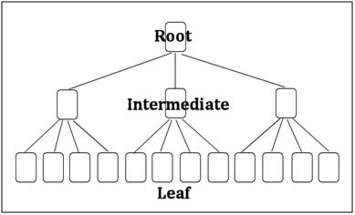
How Indexes Help
Notes:
Talk about the storage of data, all data is stored in a page. This is a clustered index, as opposed to a list of pages, which is a heap.

Slide 6
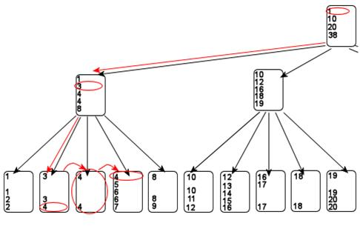
How Indexes Help
Notes:
Here we look at a search for a particular set of data, we can easily scan through for just one item in the index, ignoring other pages. The less SQL Server looks at pages, the quicker it can return results

Slide 7
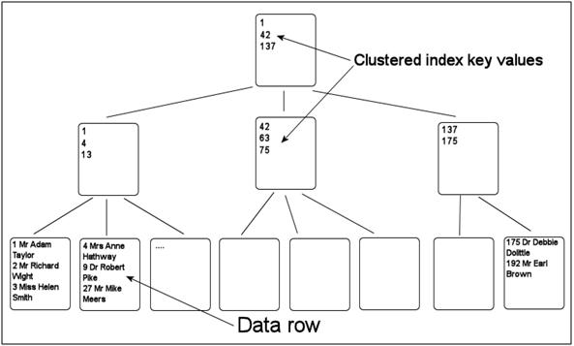
Clustered Index
The index is the data
Only one per table

Slide 8
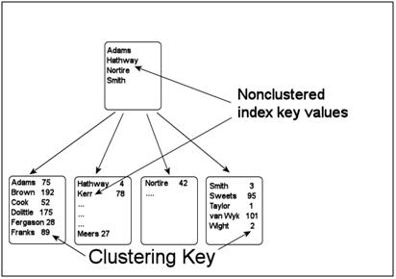
Nonclustered Index
A copy of the index key(s), included columns, and the clustered key.

Slide 9
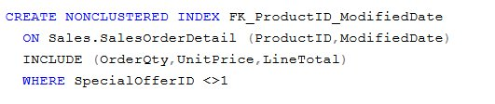
Filtered Indexes
Nonclustered indexes with a WHERE clause
Various restrictions (see references)

Slide 10
How Indexes Help
Demo
Adding an index to a table and comparing resources.
Show the missing index tag in an execution plan.
Notes:
Demos here:
Show a table in Adventure Works. Run a query. Show how a new index improves performance.
Note the “missing index” item in the execution plan

Slide 11
The Overhead of Indexes
Insert/Update/Delete activity
Storage Space
Transaction Logs

Slide 12
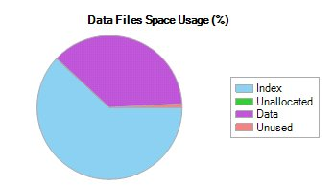
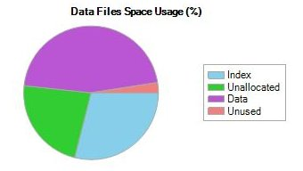
The Overhead of Indexes
Notes:
Two database reports. In one there is more data space than index space; the other is reversed. Both of these can be normal.

Slide 13
The Overhead of Indexes
Overhead is OK when performance is good
Overhead quickly becomes a problem when performance is bad.
Problem Areas
Duplicate Indexes
Unused Indexes
Fragmented Indexes

Slide 14
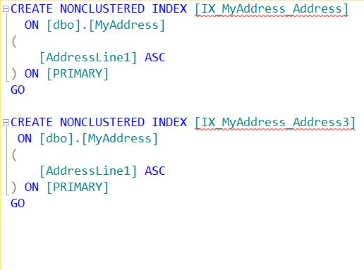
Duplicate Indexes
Are these the same?
Notes:
People don’t realize they have duplicate indexes sometimes.

Slide 15
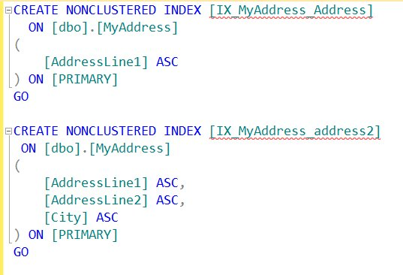
Duplicate Indexes
Are these the same?
Notes:
People don’t realize they have duplicate indexes sometimes.

Slide 16
Duplicate Indexes
Demo
Finding duplicate indexes
Show disable of duplicates, set reminder to remove.
Notes:
Use a script to find duplicate indexes. Disable the index, set a reminder to remove this in a calendar.

Slide 17

Unused Indexes
Notes:
It seems we’re constantly finding various technology devices that are no longer being used.
Are all indexes used? Perhaps not. Sometimes people create indexes because they think they might need them, or they think the optimizer will use them. That might not be the case.

Slide 18
Unused Indexes
You can find unused indexes with DMVs
sys.dm_db_index_usage_stats
Beware: DMVs can be cleared on restart
Demo
Show how to look for indexes that have not been used.
Notes:
Are all indexes used? Perhaps not. Sometimes people create indexes because they think they might need them, or they think the optimizer will use them. That might not be the case.
Scan the system for index stats, left join with indexes, find those that are not used.
Reminder, do not remove these. Disable, set reminder to check. Log the change.

Slide 19
Fragmented Indexes
Fragmentation can occur inside of an index.
Pages Splits
Deletions
Performance can be severely affected.

Slide 20
Fragmented Indexes
Fixing Fragmentation
Fill factor
Rebuild/Reorganize (online/offline)

Slide 21
Fill Factor
Fill factor is the space used on each page
Lowering fill factor can lengthen the time needed between rebuilds/reorganizes
Fill factor < 100%
Notes:
Here we can see there is a different fill factor in these tables. Fill factor of 0 = 100. Others reduce the amount of data on a page. If we lower the amount of data, we can reduce fragmentation.

Slide 22
Fill Factor
Row – 1000 Bytes
Row – 1000 Bytes
Row – 1000 Bytes
Row – 1000 Bytes
Row – 1000 Bytes
Row – 1000 Bytes
Row – 1000 Bytes
Row – 1000 Bytes
Row – 1000 Bytes
Row – 1000 Bytes
Row – 1000 Bytes
Row – 1000 Bytes
Row – 1000 Bytes
Row – 1000 Bytes
Fill factor 100 (or 0)
Fill factor 75

Slide 23
Rebuild / Reorganize
Prefer REBUILD over REORGANIZE. If you have a maintenance window, or have Enterprise Edition (online REBUILD), then use REBUILD to defragment indexes.
If you don’t have a maintenance window and don’t have EE, consider using a combination of REBUILD and REORGANIZE. Experiment with the thresholds and reduce them if the time required to run them doesn’t increase. I use 100 pages & 20% for my tradeoffs instead of 1000 pages & 30%.
Don’t defrag indexes that don’t need it, or have less than 5% external fragmentation.
Run REBUILD or REORGANIZE as often as possible, daily if possible. If you have huge databases, maybe use REORGANIZE and run a pre-defined amount of time each day.
Use pre-written scripts, as they will save you a lot of time.
Notes:
Various notes on options here

Slide 24
Statistics
Defragging index fragmentation and updating statistics are closely related and must be considered together. Keep the following in mind when creating statistics updating jobs:
If you use REORGANIZE, then you must separately update index and column statistics.
UPDATE STATISTICS table_name WITH FULLSCAN, ALL
If you use REBUILD, index statistics are automatically updated using FULLSCAN, but you must separately update column statistics.
UPDATE STATISTICS table_name WITH FULLSCAN, COLUMNS

Slide 25
Automation
The key to regular maintenance and performance
Jobs needed for:
rebuild/reorganize/statistics
Reminders
Check for duplicate/missing/unused indexes
Removal of disabled indexes after 1 business cycle

Slide 26
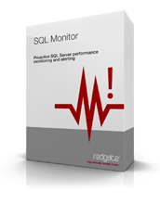
Monitoring
The key to proactive, high performance
Use monitoring for
Tracking of maintenance
Watching fragmentation
Scanning for duplicate indexes

Slide 27
Reminders (Homework)
Use your calendar (preferably shared)
Set quarterly (or sooner) reminders for
DTA/Missing Index Scans
Duplicate Index scans
Unused Index Scans
Set reminders based on results to remove indexes after a business cycle.
Notes:
Things for you to do later.

Slide 28
Goals
Understand the types of indexes and how they improve performance
Learn about the negative impact of indexes on performance
Understand the maintenance activities that should be performed regularly

Slide 29

The End
Questions?
www.sqlservercentral.com/forums
Sponsored by Red Gate Software and the SQL DBA Bundle
Speak to the Red Gate team during the breaks for more info about the tools in the SQL DBA Bundle
Backup and recovery
Troubleshooting
Productivity
Performance monitoring
Change management
Storage and capacity planning
Documentation

Slide 30
Learn More
http://www.sqlservercentral.com
http://www.red-gate.com
http://www.red-gate.com/products/dba/dba-bundle/entrypage/hard-earned-lessons
http://www.scarydba.com/tag/query-tuning/
http://voiceofthedba.wordpress.com/tag/administration/

Slide 31
References
Types of Indexes - http://msdn.microsoft.com/en-us/library/ms175049.aspx
Introduction to Indexes -http://www.sqlservercentral.com/articles/Indexing/68439/
Stairway to Indexes - http://www.sqlservercentral.com/stairway/72399/
sys.dm_db_index_physical_stats (Transact-SQL)‎
Finding Duplicate Indexes –
Sp_helpindex - http://msdn.microsoft.com/en-us/library/ms188771.aspx
Stairway to Indexing - http://www.sqlservercentral.com/stairway/72399/
The Case of the Missing Index - http://www.red-gate.com/products/dba/dba-bundle/entrypage/hard-earned-lessons

Slide 32
References
Create Filtered Indexes – http://technet.microsoft.com/en-us/library/cc280372.aspx
The Joys of Filtered Indexes - http://blogs.msdn.com/b/timchapman/archive/2012/08/27/the-joys-of-filtered-indexes.aspx
The Drawback of Using Filtered Indexes - http://blogs.msdn.com/b/timchapman/archive/2012/08/27/the-drawback-of-using-filtered-indexes.aspx
Removing Duplicate Indexes - http://www.sqlskills.com/blogs/kimberly/removing-duplicate-indexes/

Slide 33
Images
Index structures – http://www.sqlservercentral.com/articles/Indexing/68439/
Clustered Index Key Values - http://www.sqlservercentral.com/articles/Indexing/68563/
Clustered and nonclustered structures - http://www.sqlservercentral.com/articles/Indexing/68636/
Data space < index space - Data Space > Index space - http://serverfault.com/questions/455645/does-the-disk-space-used-by-this-database-seem-normal-mssql-2008
http://social.msdn.microsoft.com/Forums/en-US/sqlkjmanageability/thread/1ad5b560-84d3-4c45-bcc6-5fc8dc6ea90d/

